Slide 1
ER190C Mid-term review
October 16, 2018

Slide 2
Exploratory Data Analysis (EDA)
Lecture 6
One can approach EDA by asking questions about the data:
Structure
Granularity
Scope
Temporality
Faithfulness
See DS100 textbook for more on this topic

Slide 3
Principles of visualization
Lecture 7
Scale
Conditioning
Perception
Transformation
Context
Smoothing (e.g. kernel density estimates)

Slide 4
What can we do with data science? Rain dances vs. Umbrellas
Lecture 1
(adapted from Kleinberg AER 2017)
Consider two policy makers studying rain
One seeks to understand if a rain dance will make it rain
One seeks to decide whether or not to invest in umbrellas
Both require models and data, but
“Rain dance” problems are impact analyses. The seek to identify a causal effect.
We call “umbrella” problems resource allocation problems. They seek to predict the future so people can decide where to allocate resources and effort.
(amazon.com)

Slide 5
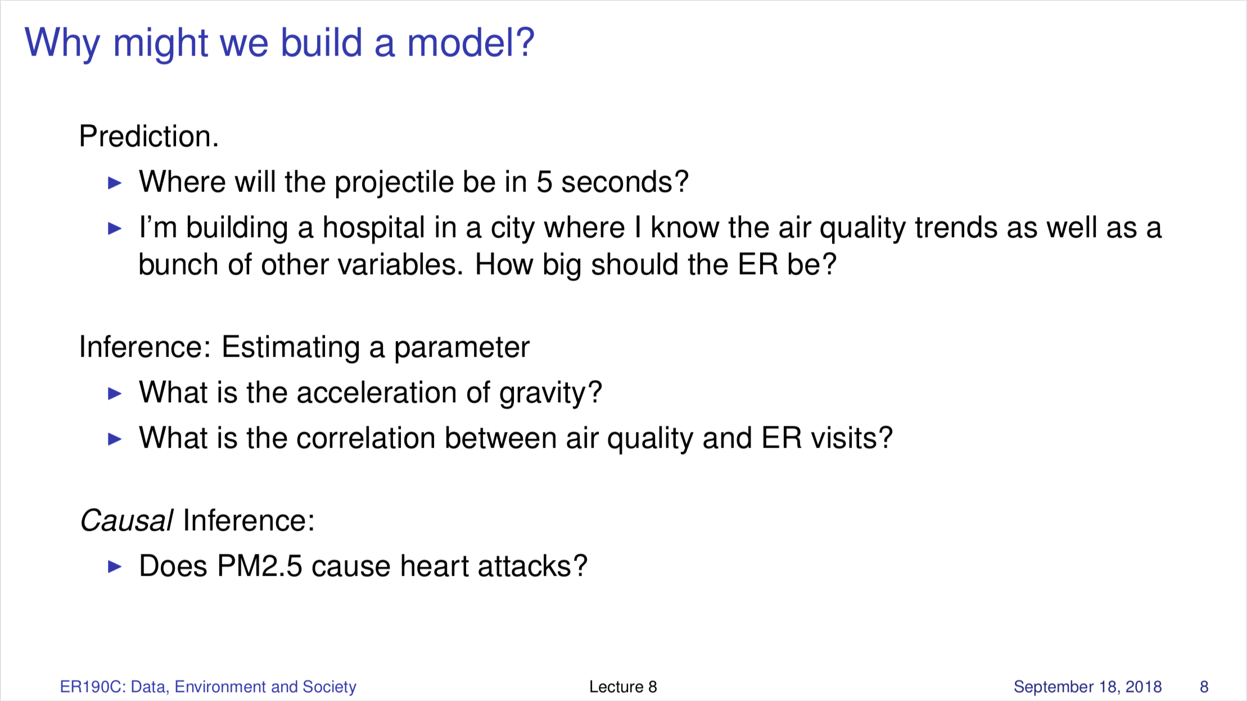
Lecture 8

Slide 6
Revisit: Why did the polls predict the wrong candidate to win the last US presidential election?
Lecture 2
Variance:
Small sample sizes leads to variance
Bias:
Sample bias. Polling firms didn’t sample the population of voters randomly.
Measurement error (untruthful responses) → Bias.
Variance and sample bias are controllable in the way we design the sample.
Measurement error is trickier, and depends on how we query the sample once it is created.

Slide 7
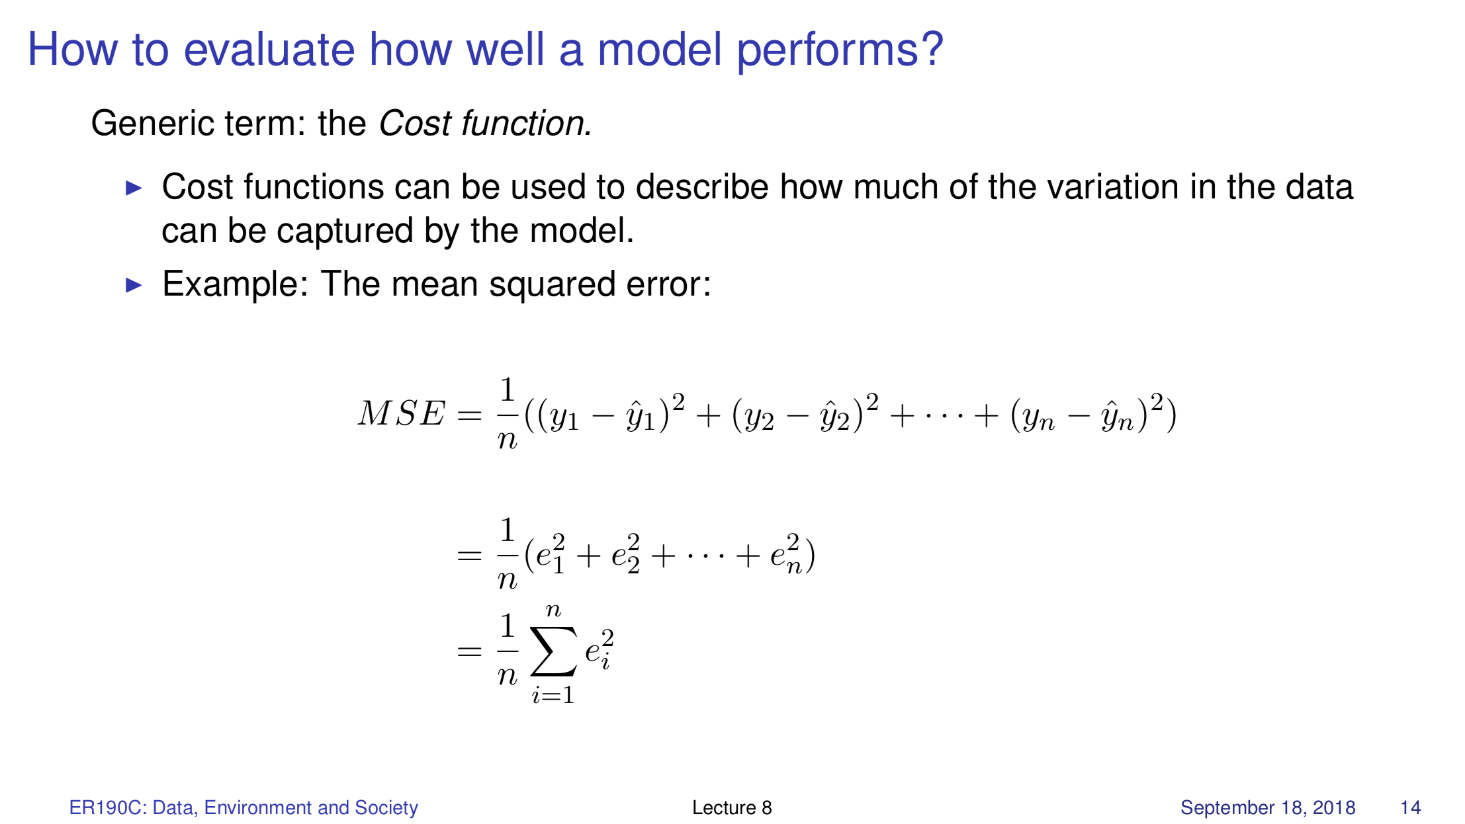
Lecture 8

Slide 8
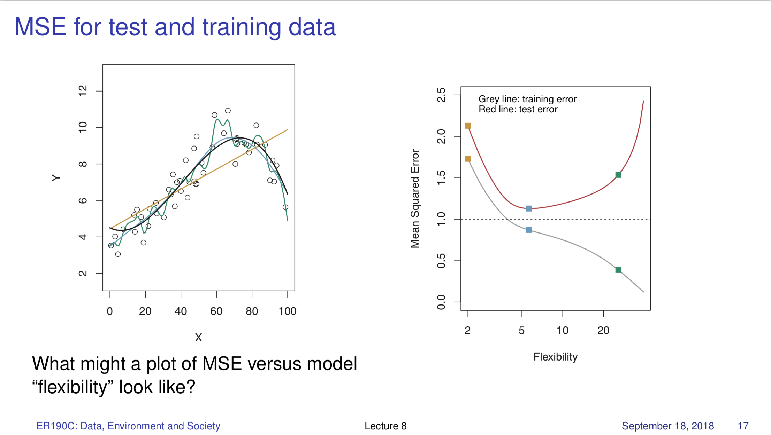
Lecture 8/9

Slide 9
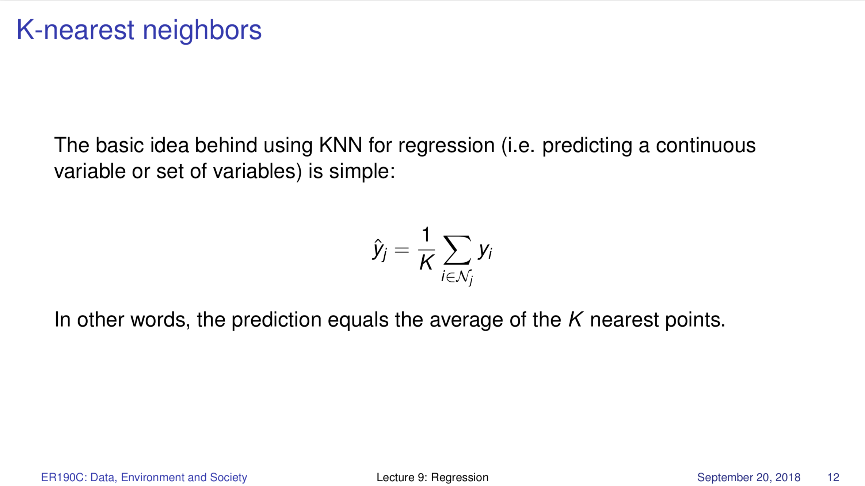
Lecture 9

Slide 10
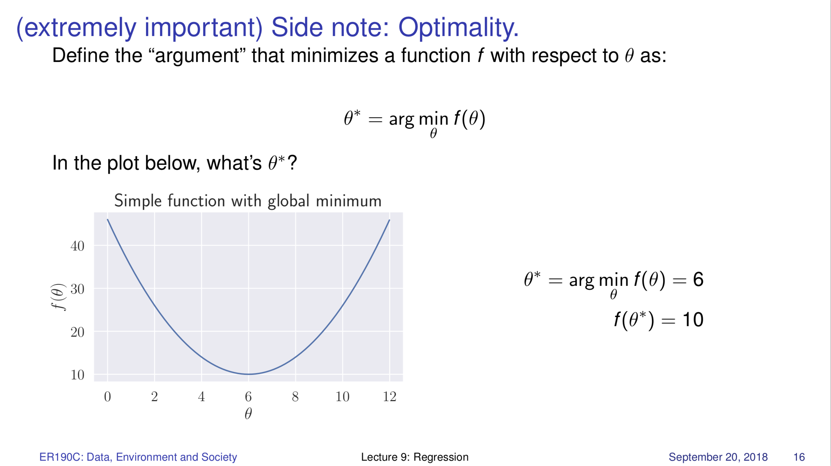
Lecture 9

Slide 11
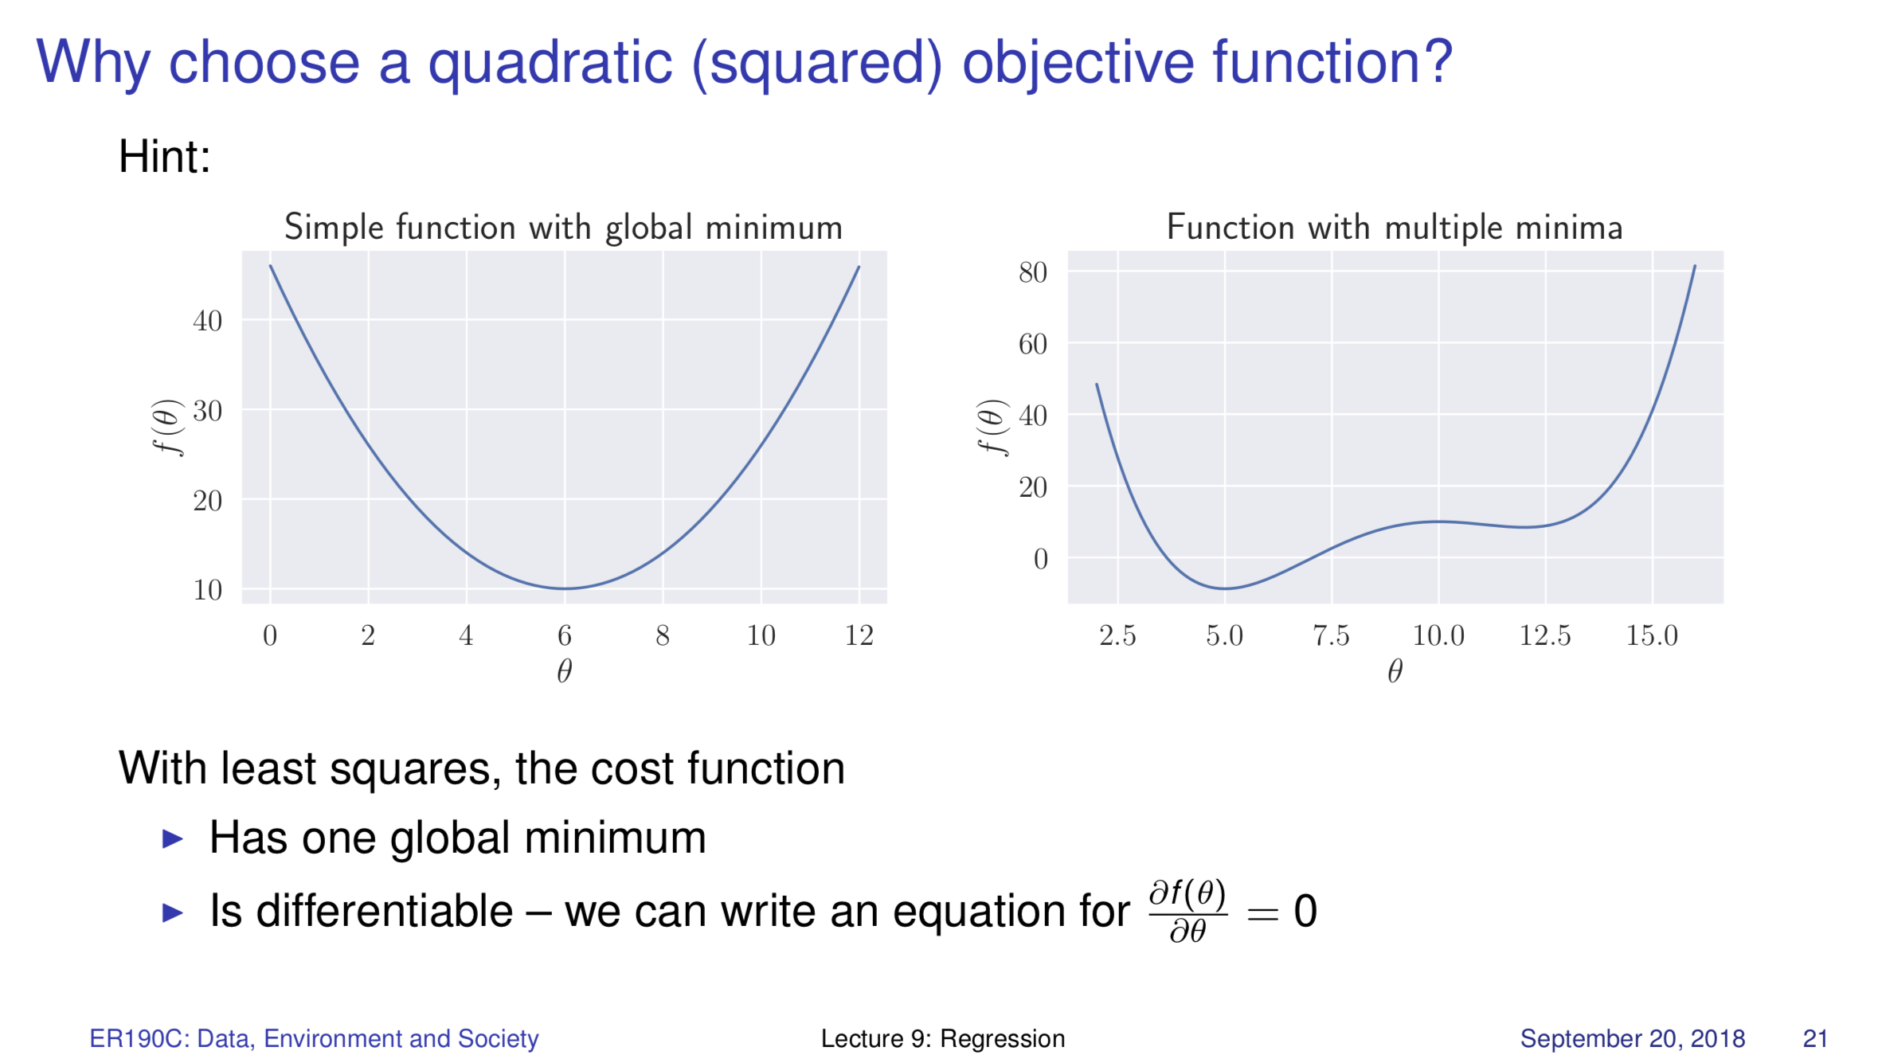
Lecture 9

Slide 12
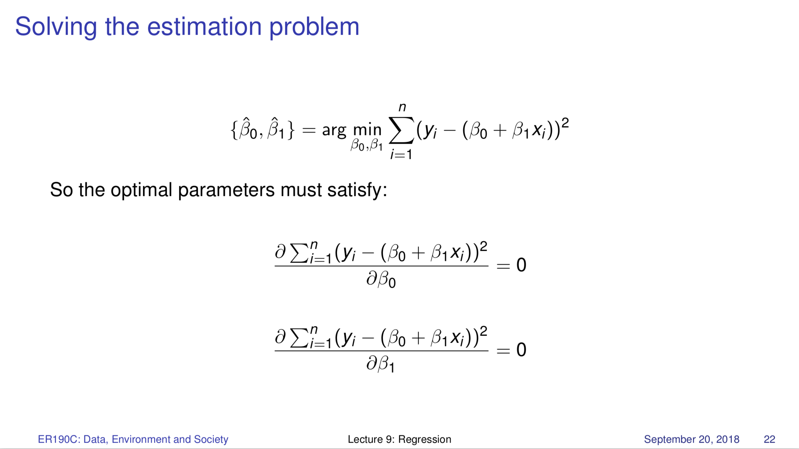
Lecture 9

Slide 13
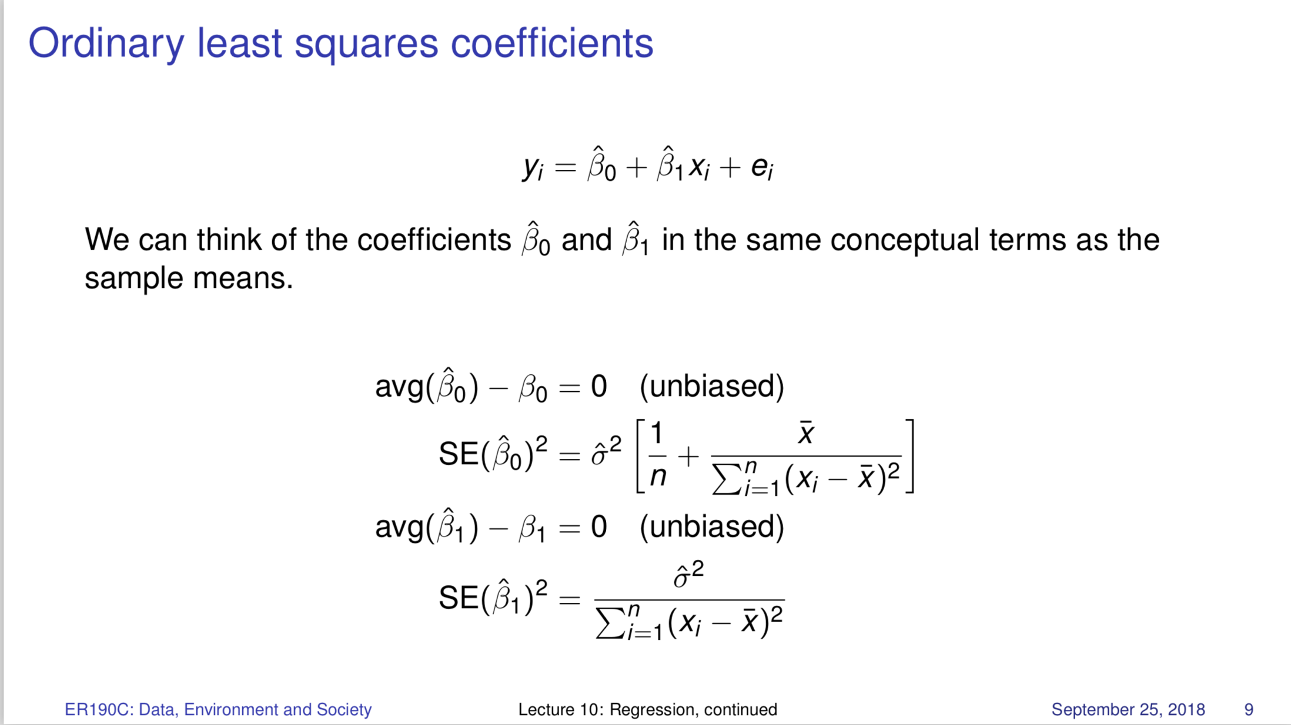
Lecture 10

Slide 14
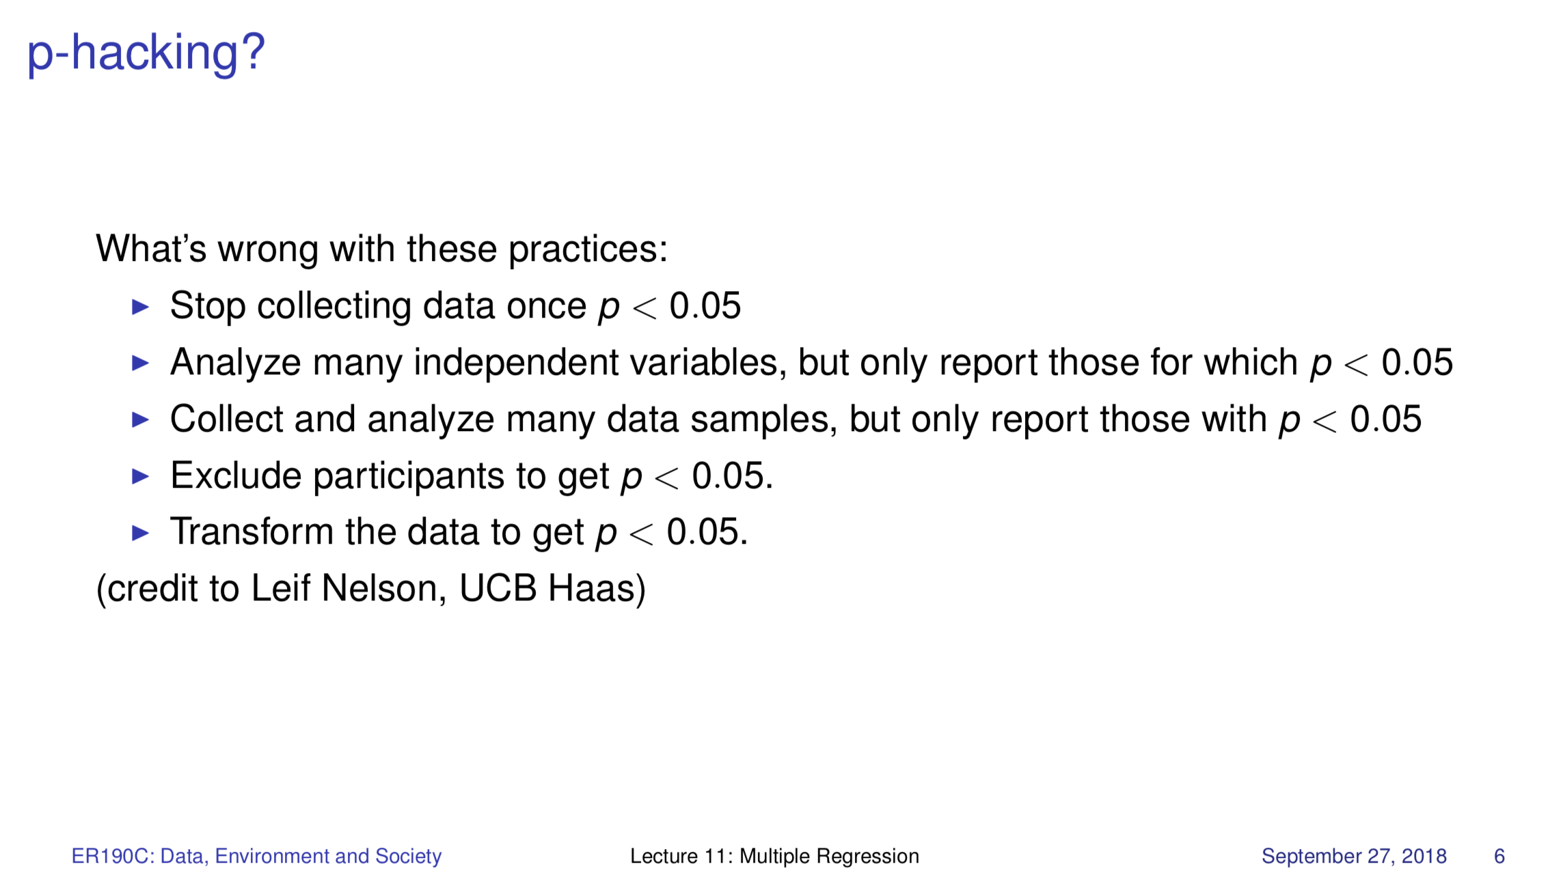
Lecture 11

Slide 15
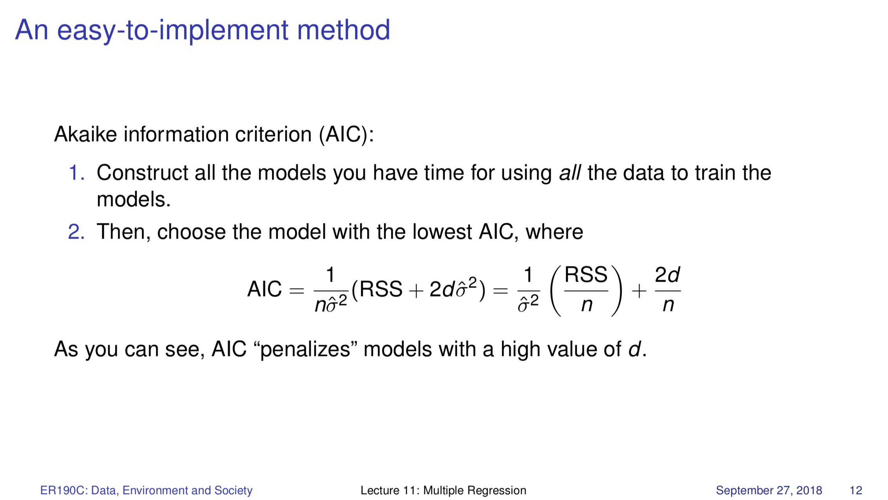
Lecture 11

Slide 16
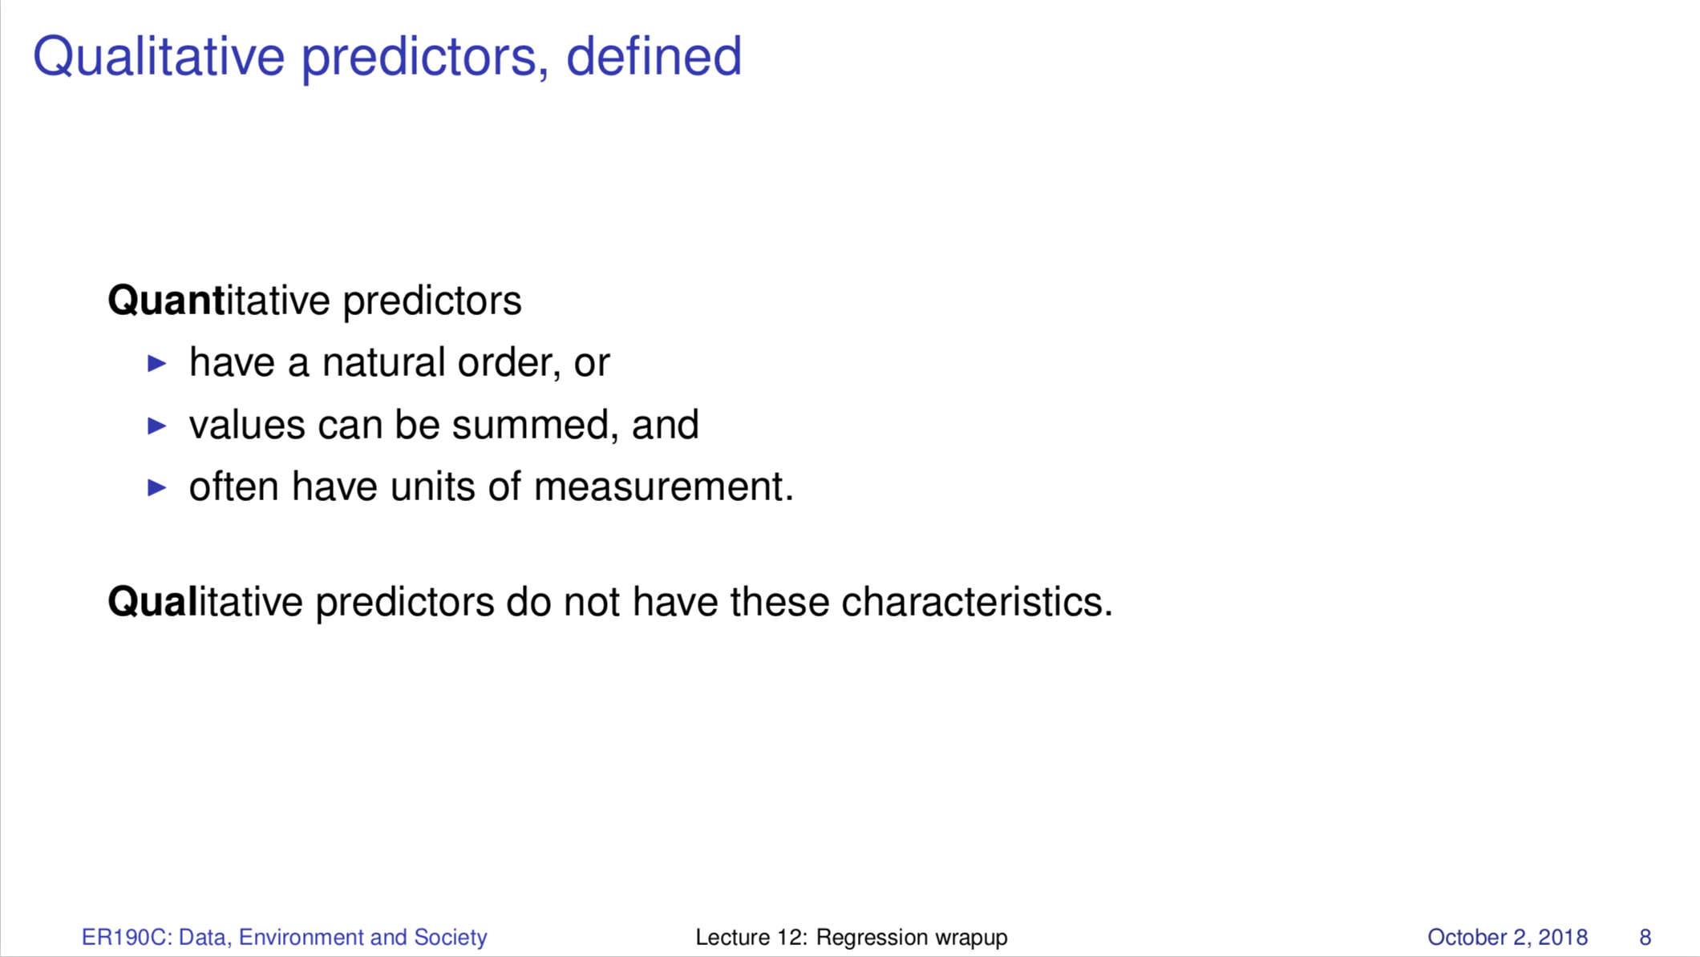
Lecture 12

Slide 17
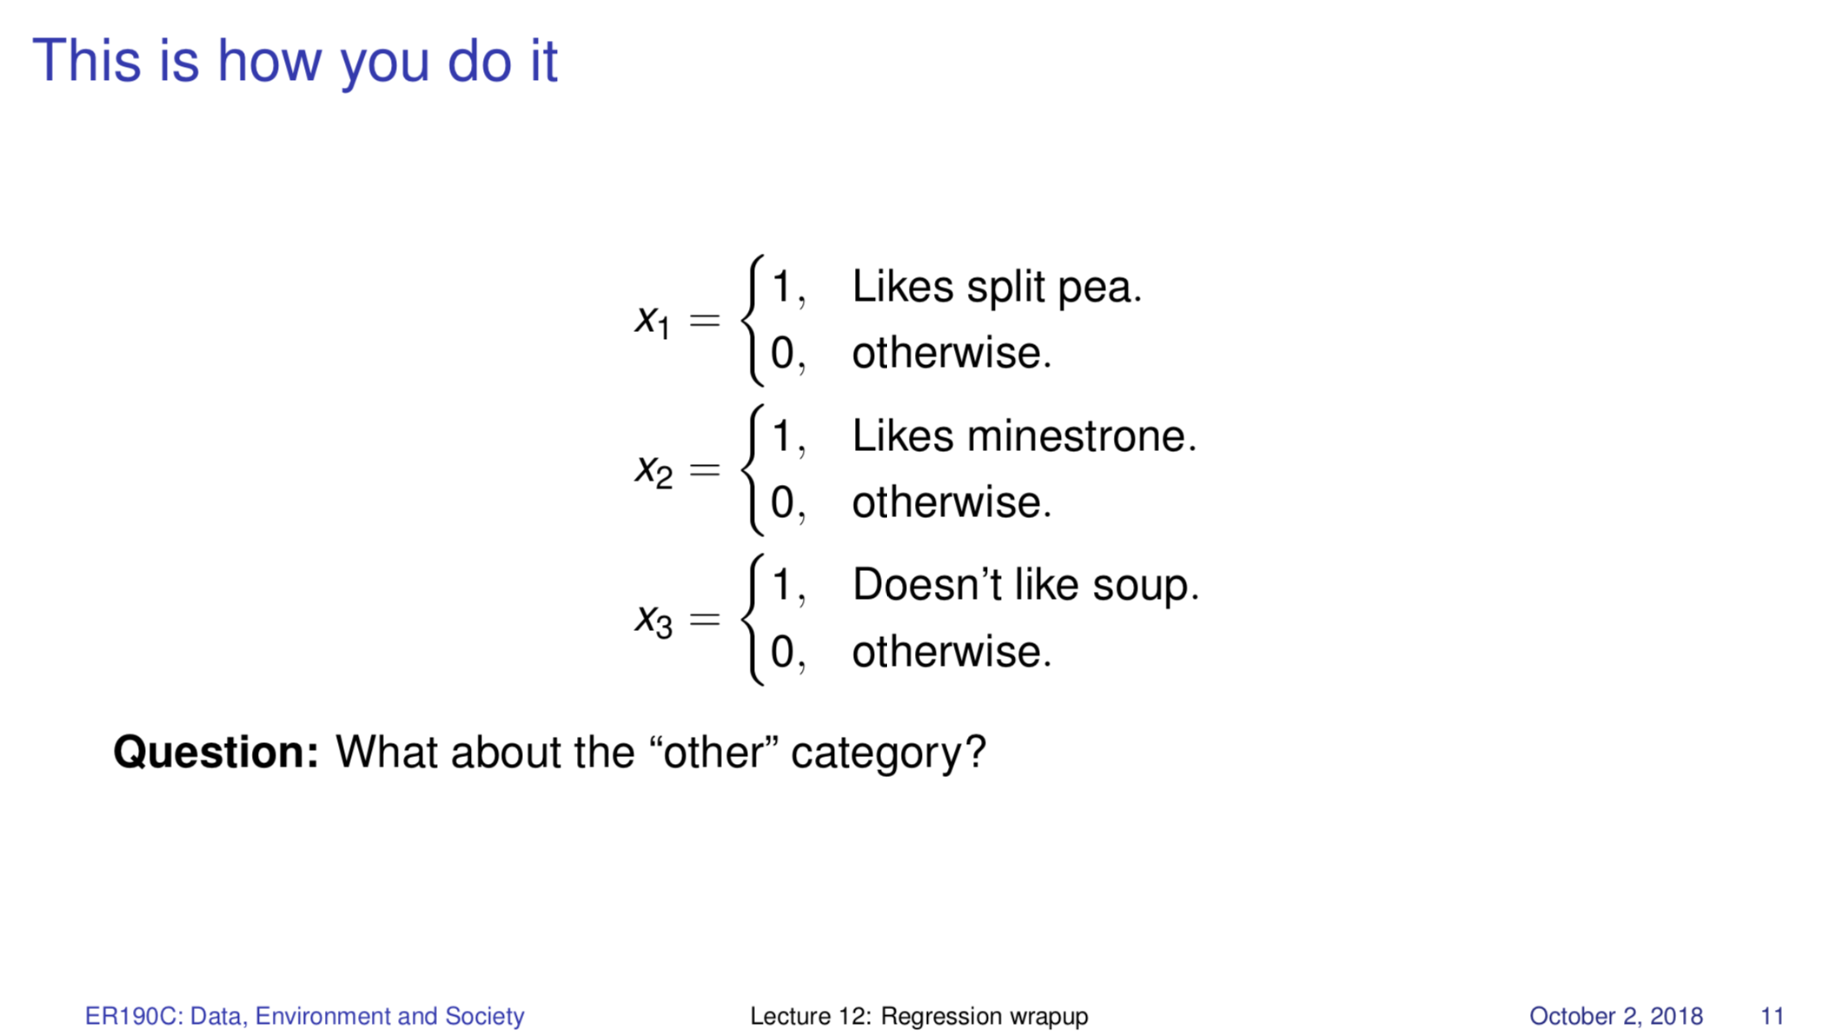
Lecture 12

Slide 18
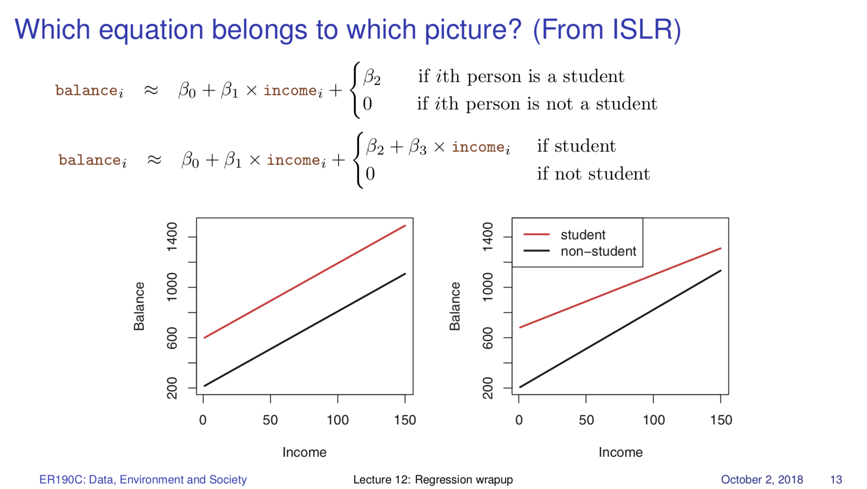
Lecture 12

Slide 19
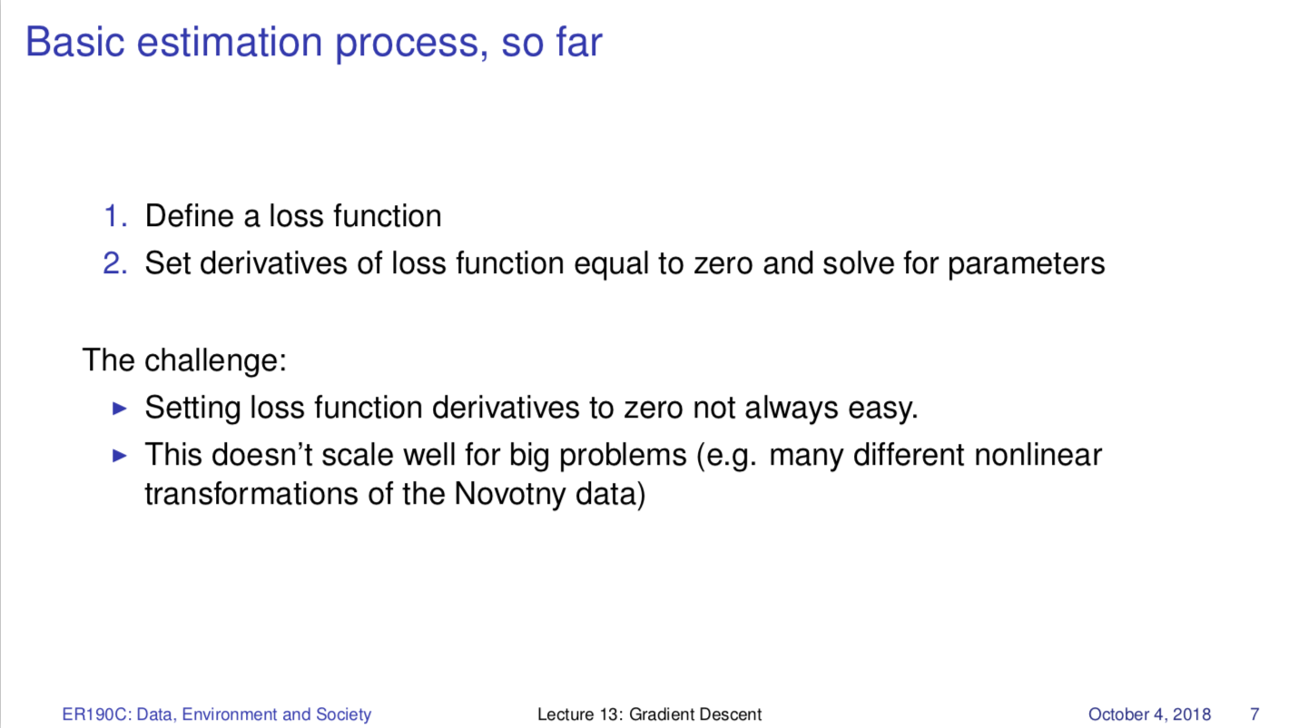
Lecture 13

Slide 20
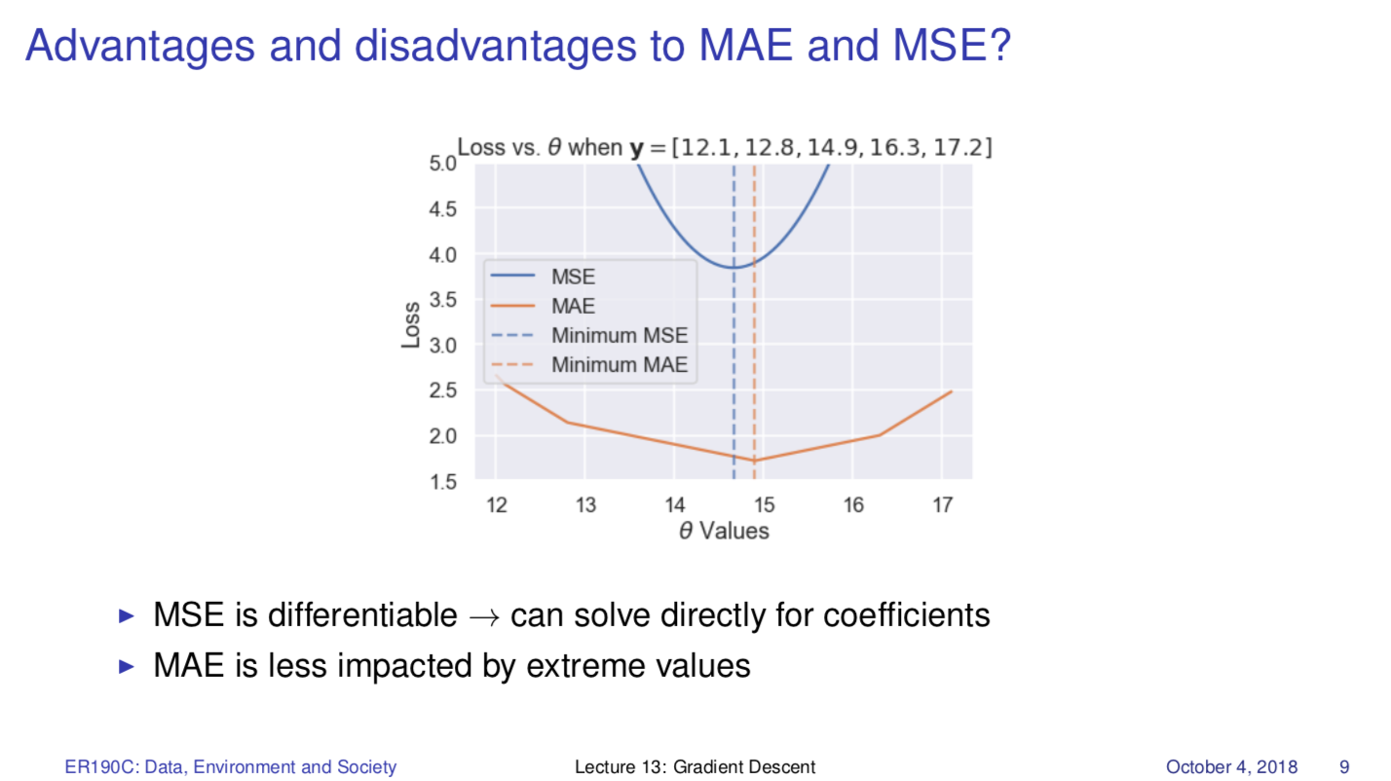
Lecture 13

Slide 21
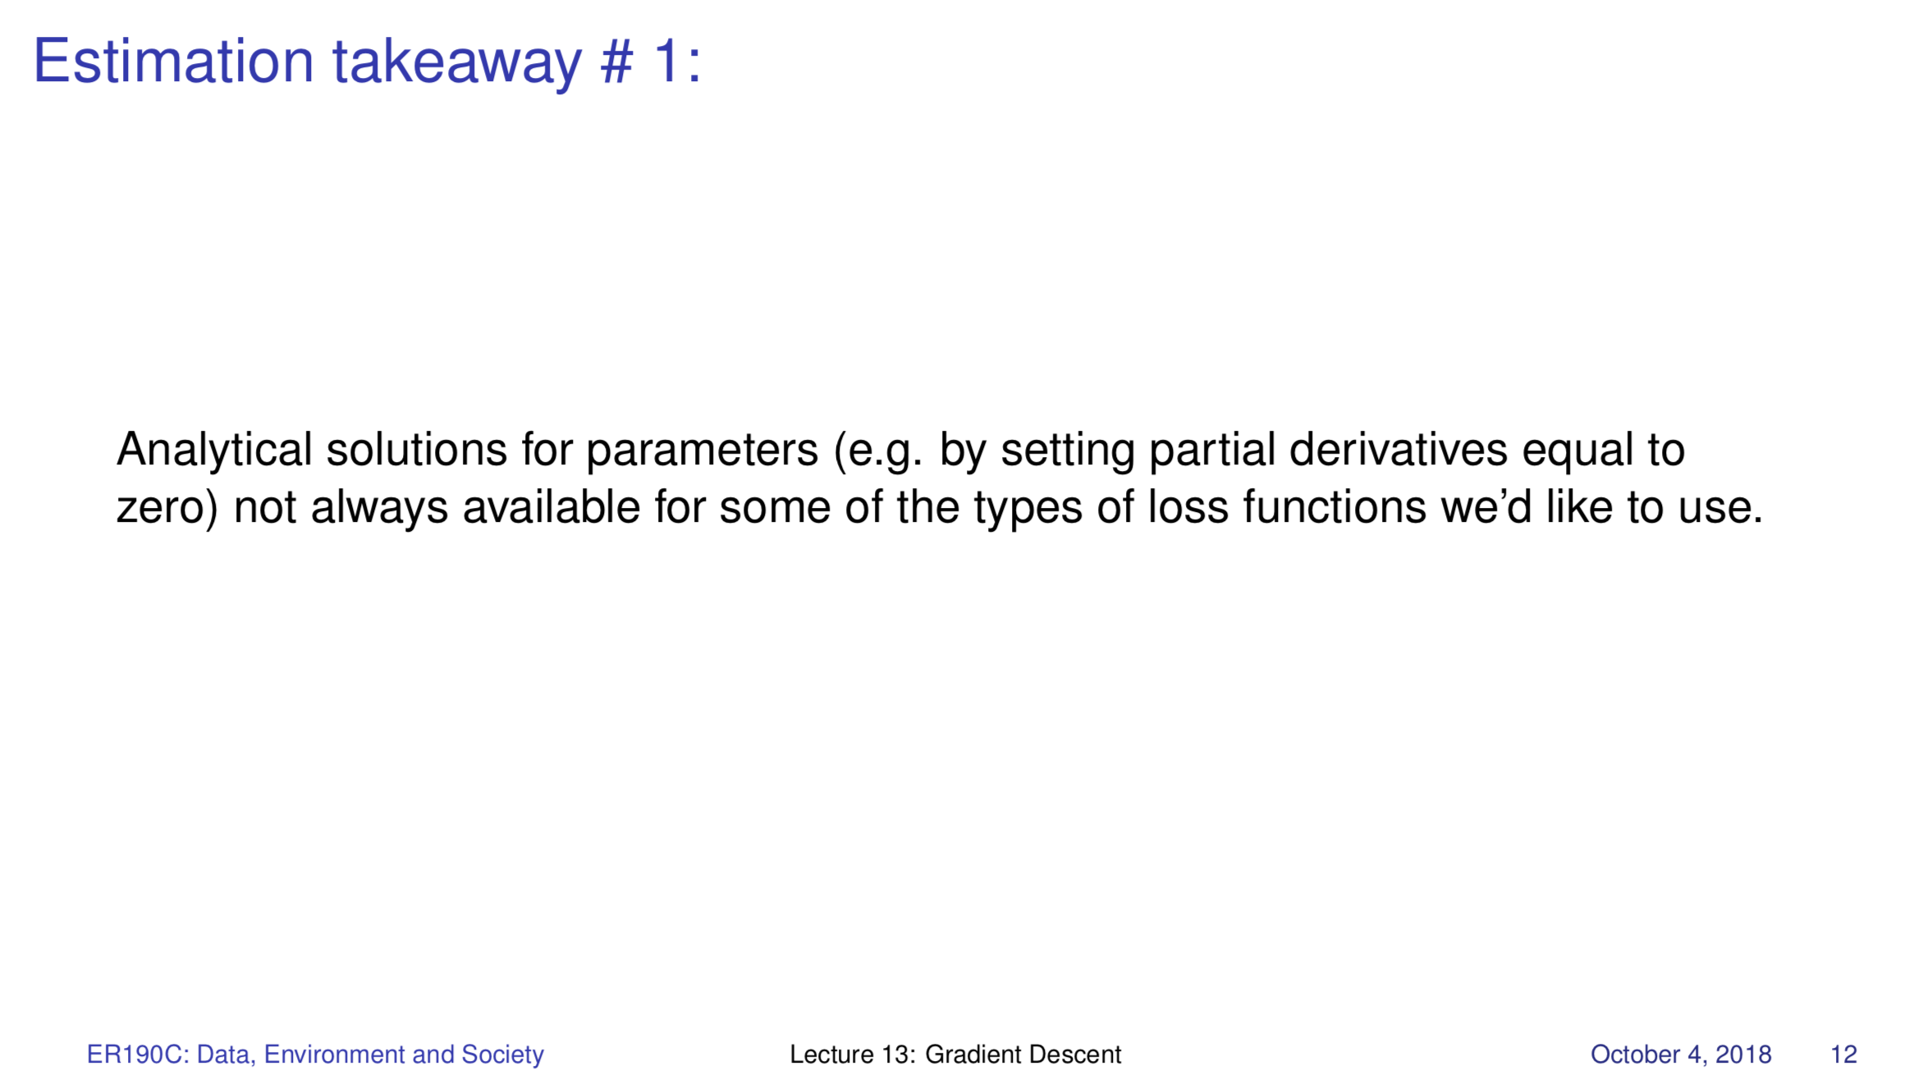
Lecture 13

Slide 22
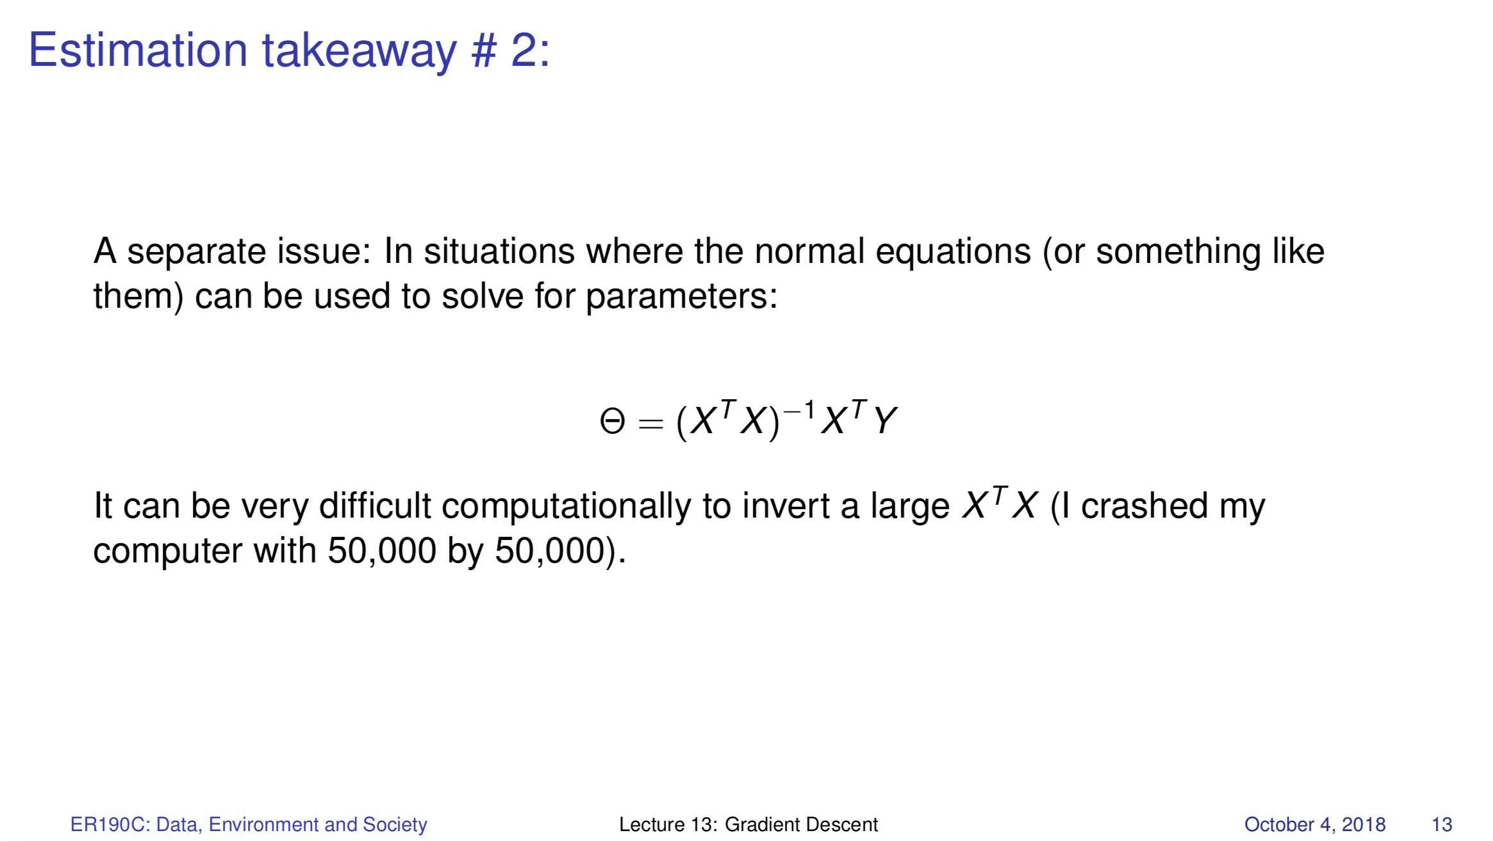
Lecture 13

Slide 23
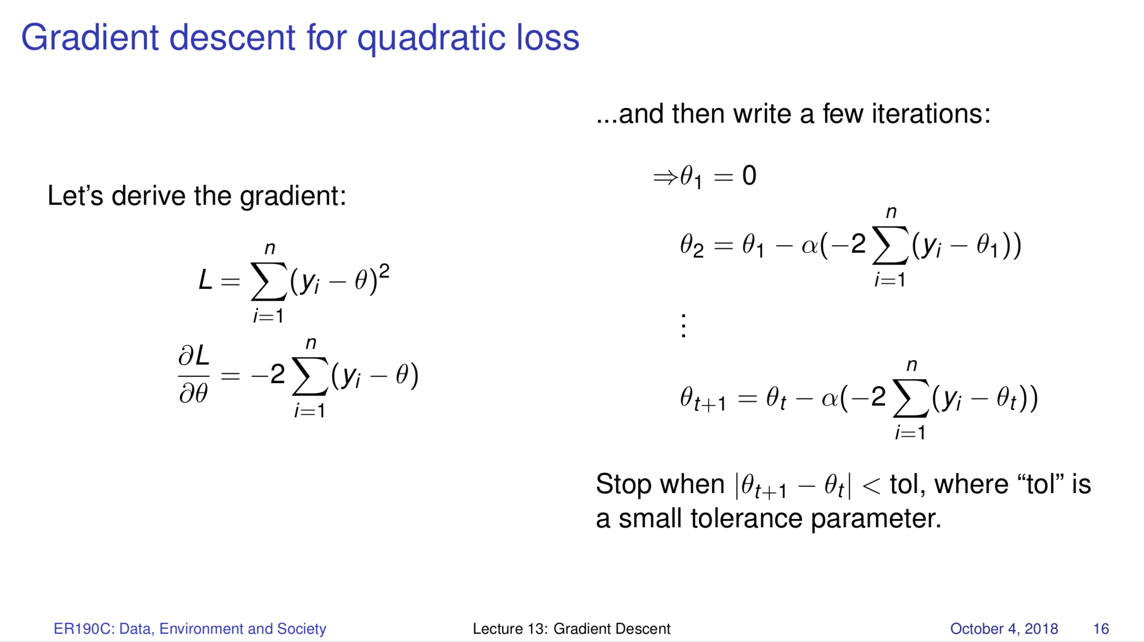
Lecture 13

Slide 24
Python
Some basics of data structures – see Lecture 3
Basic structure and use of pandas dataframes, .loc and .iloc
Different kinds of merges
Logical indexing
Very basic application of scikit-learn
Instead of writing lines of “original” code, you’ll
Read code and explain what it does
Make minor edits to code to change what it does

Slide 25
Merging update
http://www.datasciencemadesimple.com/join-merge-data-frames-pandas-python/
Lecture 7
Natural join: To keep only rows that match from the data frames, specify the argument how=‘inner’. Default in pandas.
Full outer join: To keep all rows from both data frames, specify how=‘outer’.
Left outer join: To include all the rows of your data frame x and only those from y that match, specify how=‘left’.
Right outer join: To include all the rows of your data frame y and only those from x that match, specify how=‘right’.

Slide 26
Reading
DS100 online textbook, Ch 3, 4, 5, 6, 10, 11
ISLR Ch 2, 3.1-3.3.

Slide 27
Energy and Development
What’s HDI?
How does it relate to energy consumption, energy access metrics?
Think outside the box -- if these relationships aren’t causal, what can explain them?
The Lee et al (we need central grids) vs Alstone et al (we need decentralized systems) perspective.

Slide 28
Goldemberg et al
Focus on pp 11-20 of the article (pages 1-6 of the pdf). Questions to consider:
How does the Lorenz curve relate to the national dialog the U.S. had over the 99% vs. the 1% several years ago?
What details about global living conditions and income would we miss if we use GNP per capita data at the country level?
Figure 3.5 shows factors that describe living conditions in a country versus energy use.
What kinds of conclusions can you make from this plot? What is your take on the 1 TOE barrier?
Be prepared to discuss your interpretation of this quote: "This meant that there could be a 'delinking' between GOP growth and energy growth, which did in fact take place in the industrialized countries in the 1970s and 1980s"

Slide 29
Lee et al
What sort of random sampling did Lee et al use? (e.g. stratified random sampling, probability sampling). From what population did they sample?
What can you say about the Granularity, Scope, Temporality and Faithfulness of the data Lee et al used?
Looking at Figure 1, what do you notice about the survey responses. Does anything surprise you? What does these ownership patterns imply about the relationship between household energy consumption and economic development?
What is the relationship between solar system or grid connection ownership and kerosene consumption? What explanation do the authors provide for the relationship? Do you agree with their explanation? Can you think of an alternative?
What does the paper conclude about the role of solar home systems in energy and development? Do you agree with the conclusion?

Slide 30
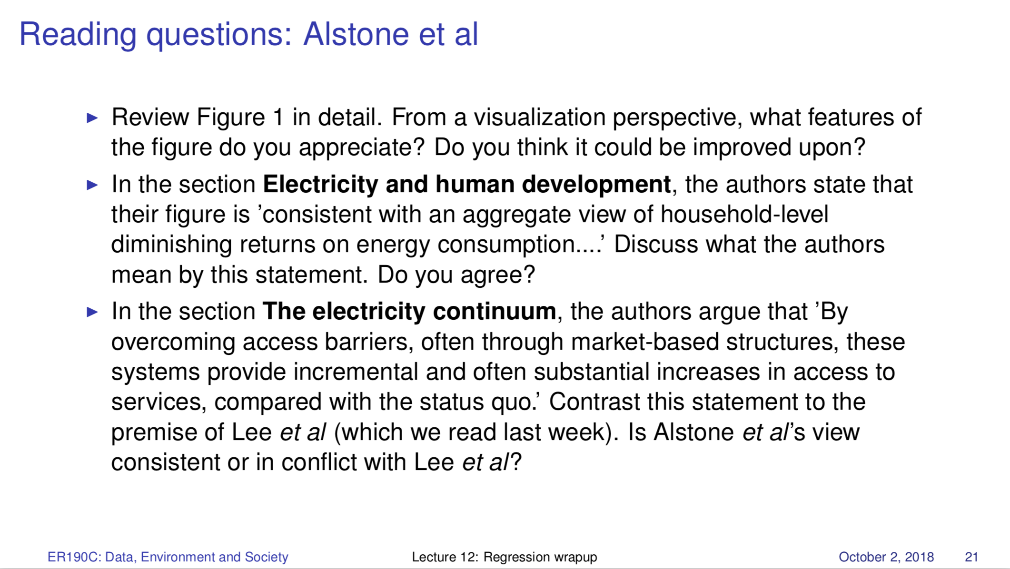

Slide 31
Land use regression

Slide 32
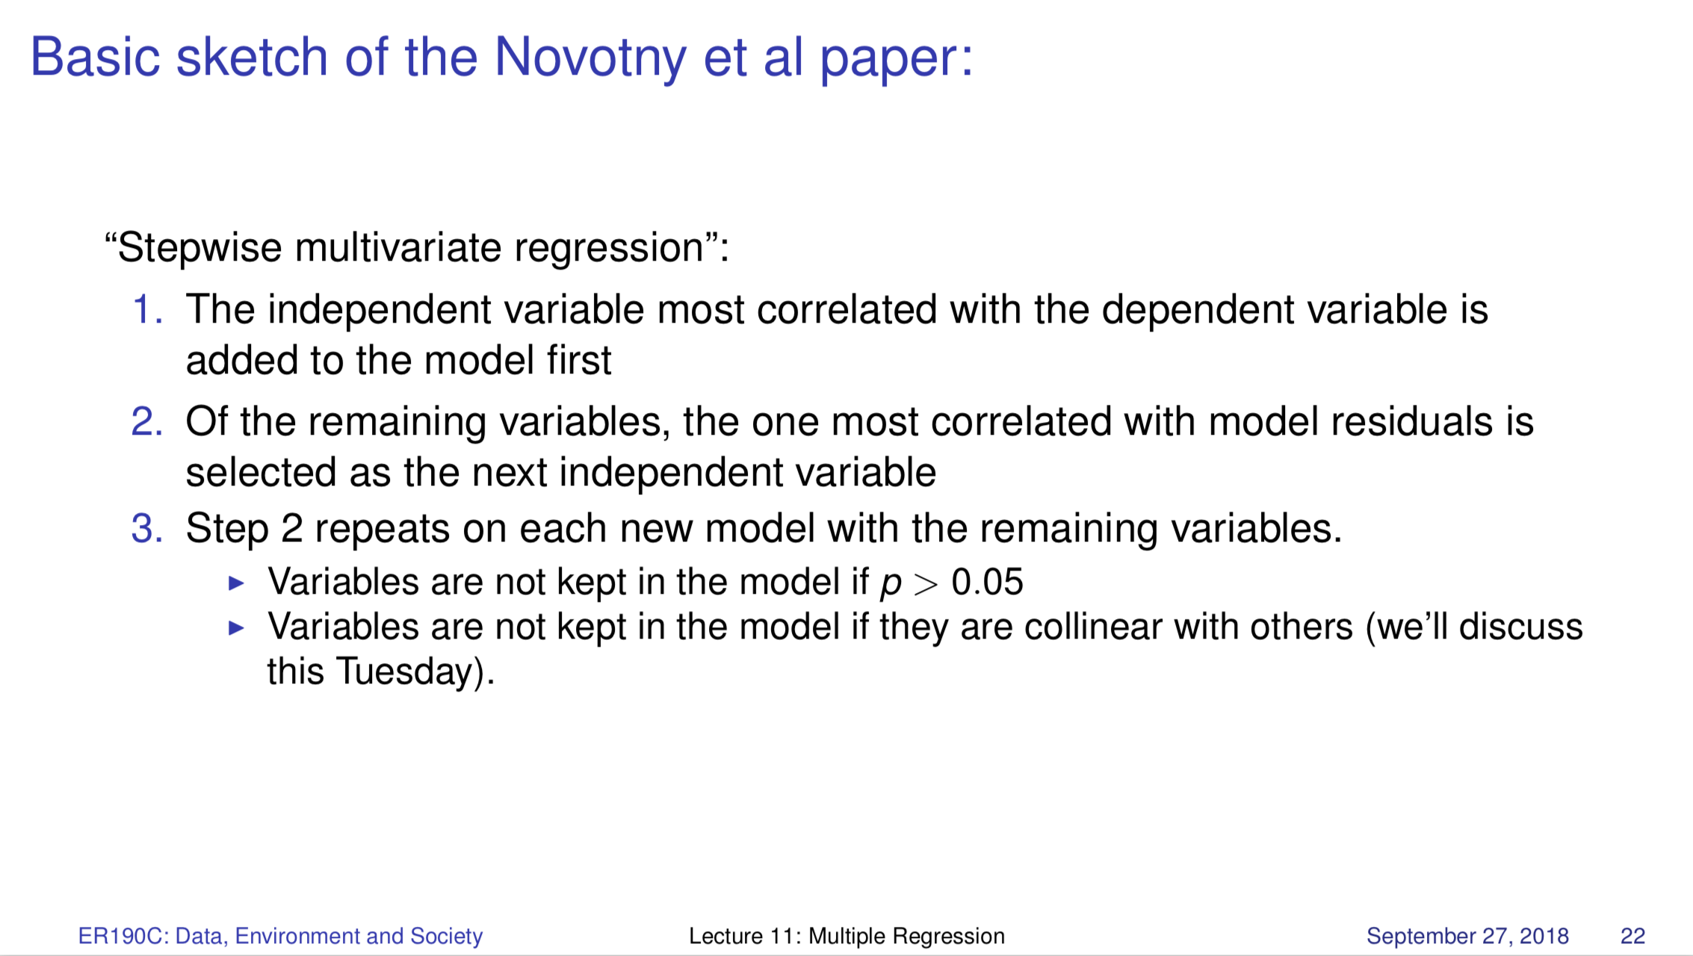
Lecture 11 /12

Slide 33
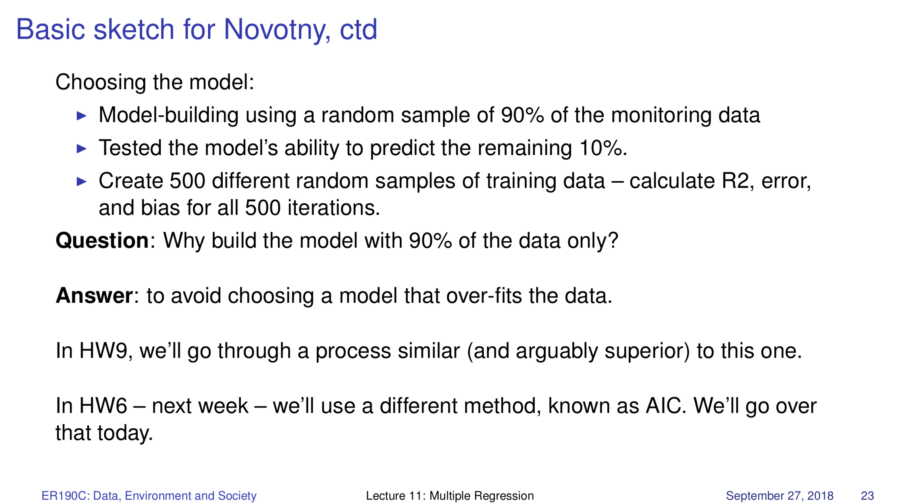
Lecture 11 /12

Slide 34
